Slide 1
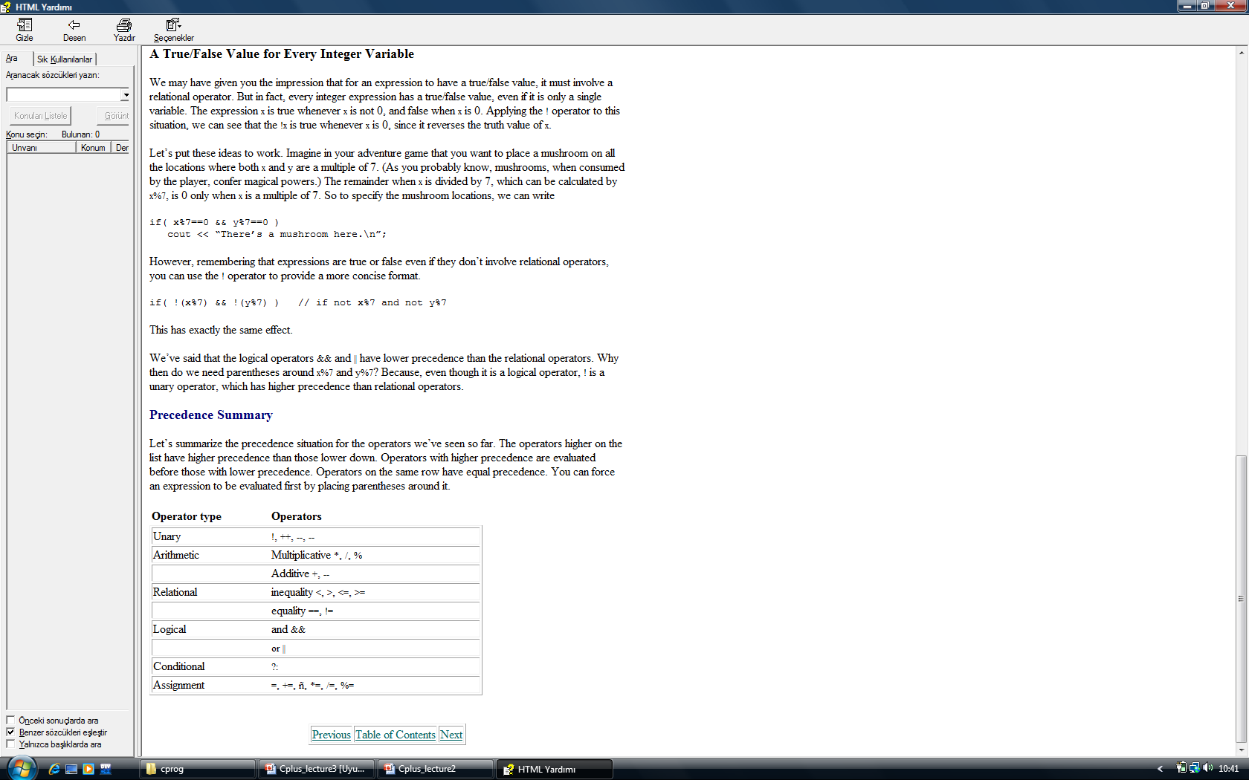
Loops
Loops cause a section of your program to be repeated a certain number of times. The repetition continues while a condition is true.
When the condition becomes false, the loop ends and control passes to the statements following the loop.
There are three kinds of loops in C++:
the for loop,
the while loop, and
the do loop.

Slide 2
For statement
The for statement enclose one or more C statement that form the body of th loop. These statements ın the loop contınuously repeat for a certaın number of tımes. We, as the programmer, control the number of loop reptıtıons.
For(start expresion; test exprestion; count expresion)
{
Block of one or more statements;
}
// Introduces the for loop
#include<stdio.h>
main()
{
int ctr;
for(ctr=1; ctr<=10; ctr++) // start ctr at 1, increment through loop
{printf(“%d \n “, ctr); } // body of loop
return 0;
}

Slide 3
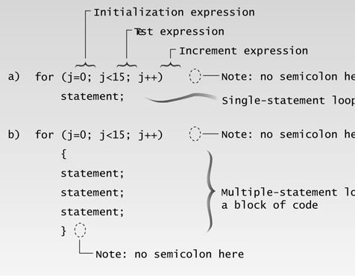
// fordemo.cpp
// demonstrates simple FOR loop
#include <iostream>
using namespace std;
int main()
{
int j; //define a loop variable
for(j=0; j<15; j++) //loop from 0 to 14,
cout << j * j << “ ”; //displaying the square of j
cout << endl; return 0;
}
Here’s the output:
0 1 4 9 16 25 36 49 64 81 100 121 144 169 196

Slide 4
For statement
The following sample program adds the numbers from 100 to 200.
// Introduces the for loop
#include<stdio.h>
main()
{
int total,ctr;
total=0; // wıll hold total of 100 to 200
for(ctr=100; ctr<=200; ctr++) // ctr is 100,101,…,200
{total+=ctr;} // add value of ctr each iteration
printf(“ the total ıs %d \n “, total);
return 0;
}

Slide 5
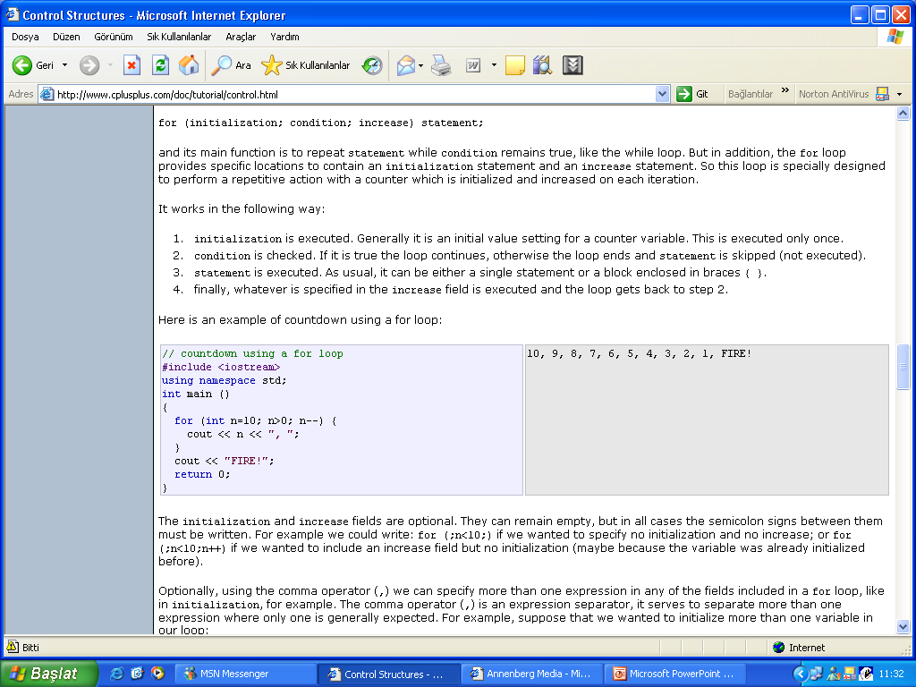
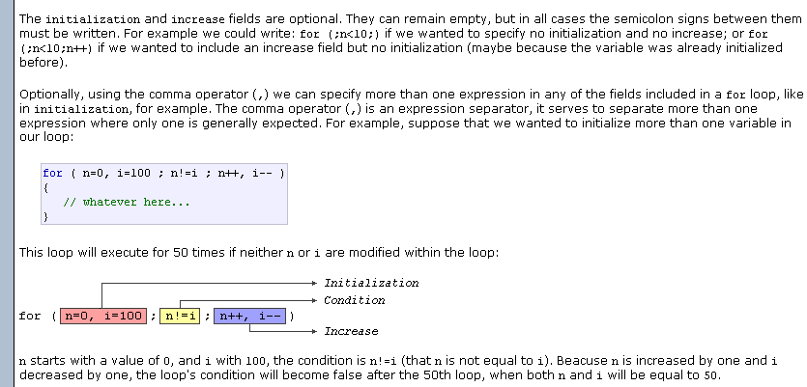

Slide 6
An example of using a for loop to print out characters
#include <stdio.h>
main()
{
char letter;
for( letter = 'A'; letter <= ‘Z'; letter = letter + 1 )
{
printf("%c ", letter);
}
}
Sample Program Output
A B C D E …

Slide 7
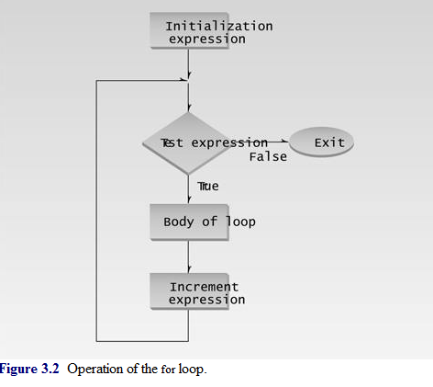
The Increment Expression
The increment expression changes the value of the loop variable, often by incrementing it. It is always executed at the end of the loop, after the loop body has been executed. Here the increment operator ++ adds 1 to j each time through the loop. Figure 3.2 shows a flowchart of a for loop’s operation.

Slide 8
How Many Times?
Here’s another for loop example:
for(count=0; count<100; count++) // loop body
How many times will the loop body be repeated here?
Exactly 100 times, with count going from 0 to 99.
Multiple Statements in Loop Body
Of course you may want to execute more than one statement in the loop body. Multiple statements are delimited by braces, just as functions are. Note that there is no semicolon following the final brace of the loop body, although there are semicolons following the individual statements in the loop body.
// cubelist.cpp
// lists cubes from 1 to 10
#include <iostream>
#include <iomanip> //for setw
using namespace std;
int main()
{
int numb; //define loop variable
for(numb=1; numb<=10; numb++) //loop from 1 to 10
{
cout << setw(4) << numb; //display 1st column int
cube = numb*numb*numb; //calculate cube
cout << setw(6) << cube << endl; //display 2nd column
}
return 0; }
Here’s the output from the program:
1 1
2 8
3 27
4 64
5 125
6 216
7 343
8 512
9 729
10 1000

Slide 9
The while Loop
The for loop does something a fixed number of times. What happens if you don’t know how many times you want to do something before you start the loop? In this case a different kind of loop may be used: the while loop.
The next example,asks the user to enter a series of numbers. When the number entered is 0, the loop terminates. Notice that there’s no way for the program to know in advance how many numbers will be typed before the 0 appears; that’s up to the user.
// demonstrates WHILE loop
#include <iostream>
using namespace std;
int main()
{
int n = 99; // make sure n isn’t initialized to 0
while( n != 0 ) // loop until n is 0
cin >> n; // read a number into n
cout <<n<< endl;
return 0;
}
1
27
33
144
9
0

Slide 10
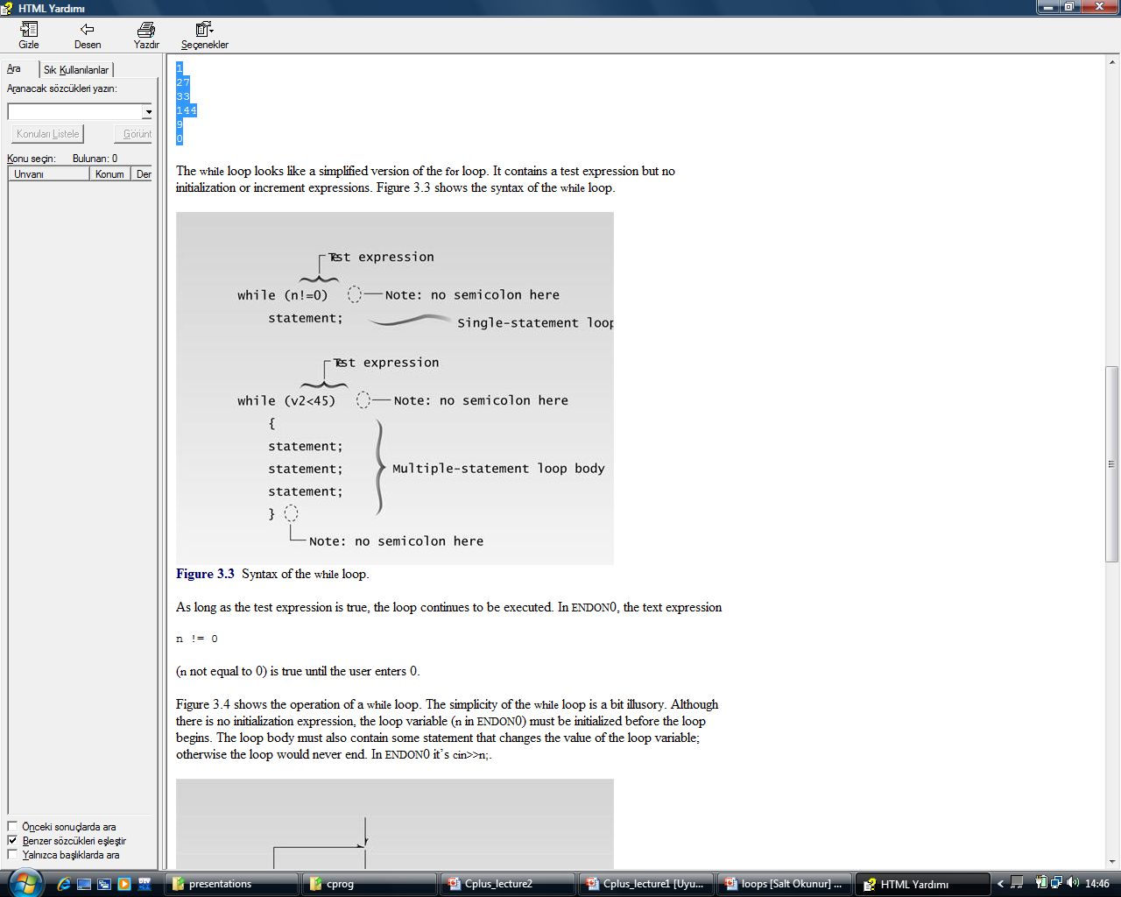
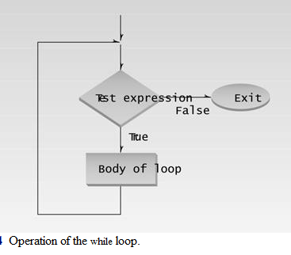

Slide 11
Multiple Statements in while Loop
// while4.cpp
// prints numbers raised to fourth power
#include <iostream>
#include <iomanip> //for setw
using namespace std;
int main()
{
int pow=1; //power initially 1
int numb=1; //numb goes from 1 to ???
while( pow<9999 ) //loop while power <= 4 digits
{
cout << setw(2) << numb; //display number
cout << setw(5) << pow << endl; //display fourth power
++numb; //get ready for next power
pow = numb*numb*numb*numb; //calculate fourth power
}
cout << endl;
return 0;
}
Output
1 1
2 16
3 81
4 256
5 625
6 1296
7 2401
8 4096
9 6561

Slide 12
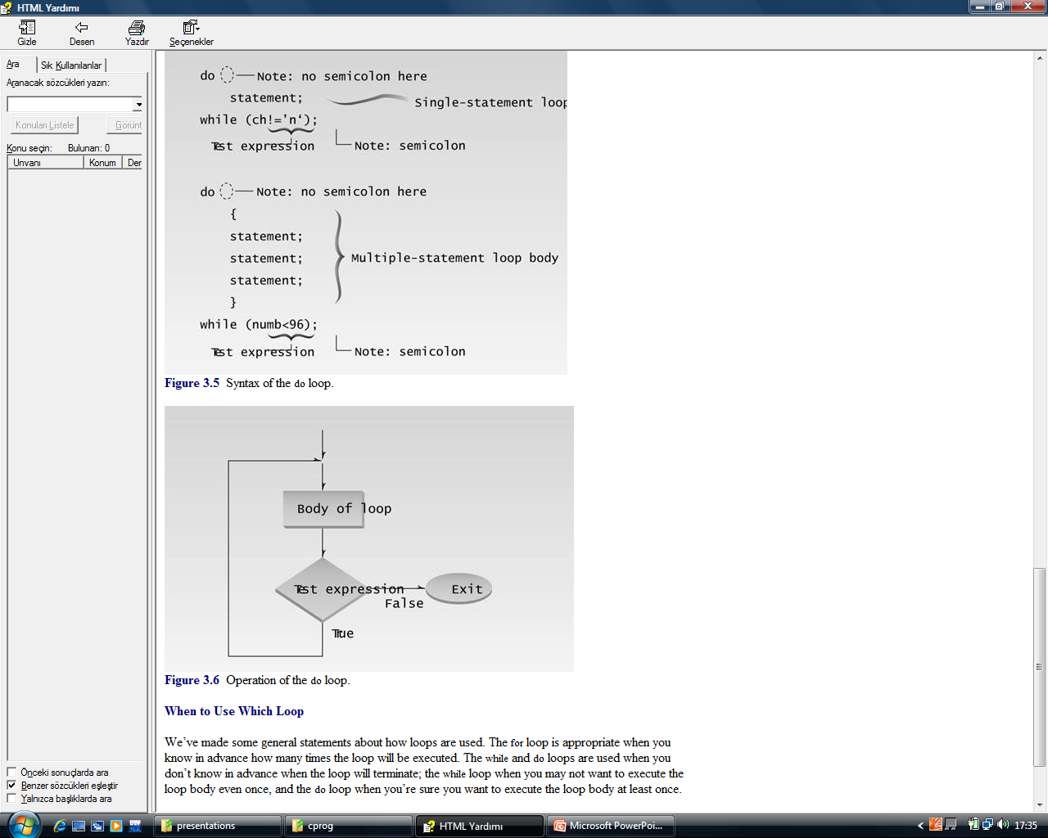
The do Loop
In a while loop, the test expression is evaluated at the beginning of the loop. If the test expression is false when the loop is entered, the loop body won’t be executed at all. In some situations this is what you want. But sometimes you want to guarantee that the loop body is executed at least once, no matter what the initial state of the test expression. When this is the case you should use the do loop, which places the test expression at the end of the loop.

Slide 13
// divdo.cpp
// demonstrates DO loop
#include <iostream>
using namespace std;
int main()
{
long dividend, divisor;
char ch;
do //start of do loop
{ //do some processing
cout << “Enter dividend: ”; cin >> dividend;
cout << “Enter divisor: ”; cin >> divisor;
cout << “Quotient is ” << dividend / divisor;
cout << “, remainder is ” << dividend % divisor;
cout << “\nDo another? (y/n): ”; //do it again?
cin >> ch;
} while( ch != ‘n’ ); //loop condition
return 0;
}
output
Enter dividend: 11
Enter divisor: 3
Quotient is 3, remainder is 2 Do another? (y/n): y
Enter dividend: 222
Enter divisor: 17
Quotient is 13, remainder is 1 Do another? (y/n): n

Slide 14
Decisions
The decisions in a loop always relate to the same question: Should we do this (the loop body) again? As humans we would find it boring to be so limited in our decision-making processes. We need to decide, not only whether to go to work again today (continuing the loop), but also whether to buy a red shirt or a green one (or no shirt at all), whether to take a vacation, and if so, in the mountains or by the sea.
Programs also need to make these one-time decisions. In a program a decision causes a one-time jump to a different part of the program, depending on the value of an expression. Decisions can be made in C++ in several ways. The most important is with the if...else statement, which chooses between two alternatives. This statement can be used without the else, as a simple if statement. Another decision statement, switch, creates branches for multiple alternative sections of code, depending on the value of a single variable. Finally the conditional operator is used in specialized situations. We’ll examine each of these constructions.

Slide 15
The if statement is the simplest of the decision statements. Our next program, IFDEMO, provides an example.
// ifdemo.cpp
// demonstrates IF statement
#include <iostream>
using namespace std;
int main()
{
int x;
cout << “Enter a number: ”;
cin >> x;
if( x > 100 )
cout << “That number is greater than 100\n”;
return 0;
}

Slide 16
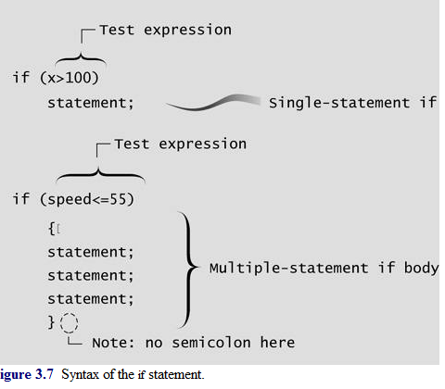
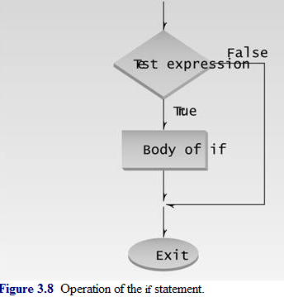

Slide 17
Multiple Statements in the if Body
// if2.cpp
// demonstrates IF with multiline body
#include <iostream>
using namespace std;
int main()
{
int x;
cout << “Enter a number: ”;
cin >> x;
if( x > 100 )
{
cout << “The number ” << x;
cout << “ is greater than 100\n”; }
return 0;
}
Here’s some output from IF2:
Enter a number: 12345
The number 12345 is greater than 100

Slide 18
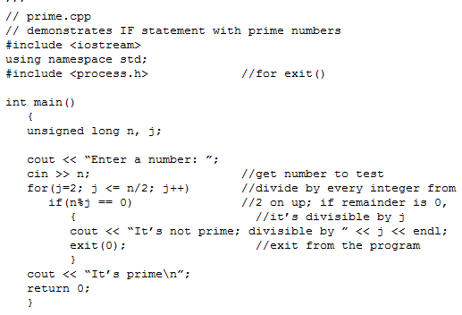
This example tells you if a number you enter is a prime number. (Prime numbers are integers divisible only by themselves and 1. The first few primes are 1, 2, 3, 5, 7, 11, 13, 17.)

Slide 19
Library Function exit()
When PRIME discovers that a number is not prime, it exits immediately, since there’s no use proving more than once that a number isn’t prime. This is accomplished with the library function exit(). This function causes the program to terminate, no matter where it is in the listing. It has no return value. Its single argument, 0 in our example, is returned to the operating system when the program exits. (This value is useful in batch files, where you can use the ERRORLEVEL value to query the return value provided by exit(). The value 0 is normally used for a successful termination; other numbers indicate errors.)

Slide 20
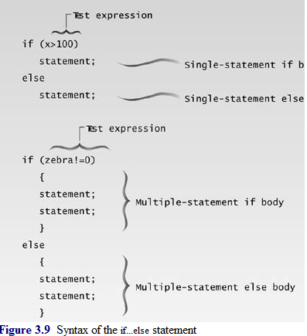
The if...else Statement
The if statement lets you do something if a condition is true. If it isn’t true, nothing happens. But suppose we want to do one thing if a condition is true, and do something else if it’s false. That’s where the if...else statement comes in. It consists of an if statement, followed by a statement or block of statements, followed by the keyword else, followed by another statement or block of statements.

Slide 21
// ifelse.cpp
// demonstrates IF...ELSE statememt
#include <iostream>
using namespace std;
int main()
{
int x;
cout << “\nEnter a number: ”;
cin >> x;
if( x > 100 )
cout << “That number is greater than 100\n”;
else
cout << “That number is not greater than 100\n”;
return 0;
}
Enter a number: 300
That number is greater than 100
Enter a number: 3
That number is not greater than 100

Slide 22
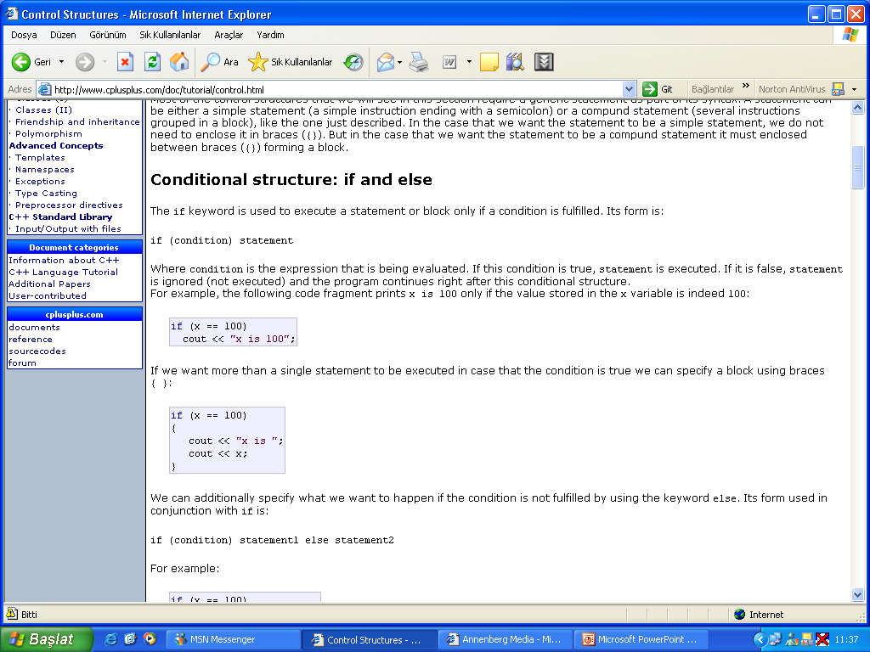

Slide 23
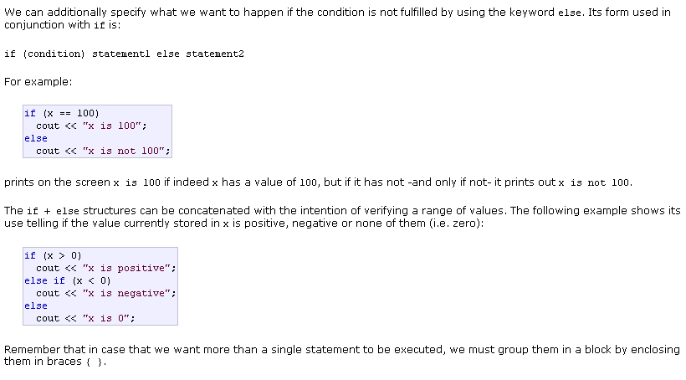

Slide 24
// the for loop example
#include<stdio.h>
main()
{
char child[25]; // hold child’s first name
int age; // holds child’s age
int ctr; // The for loop counter carıables
for(ctr=1; ctr<=5; ctr++) // ctr is 1,2,…,5
{ printf(“ what is the next chıld’s name? “);
scanf(“ %s”, child);
printf(“ what is the child’s age? “);
scanf(“ %d”, &age);
if (age<=5)
{printf(“ \n %s has Mrs. Jones for a teacher \n “, child); }
if (age==6)
{printf(“ \n %s has Miss. Smith for a teacher \n “, child); }
if (age>=7)
{printf(“ \n %s has Mr. Anderson for a teacher \n “, child); }
} // quits after 5 times
return 0;
}

Slide 25
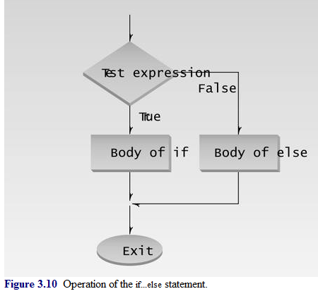
The getche() Library Function
Our next example shows an if...else statement embedded in a while loop. It also introduces a new library function: getche(). This program, CHCOUNT, counts the number of words and the number of characters in a phrase typed in by the user.

Slide 26
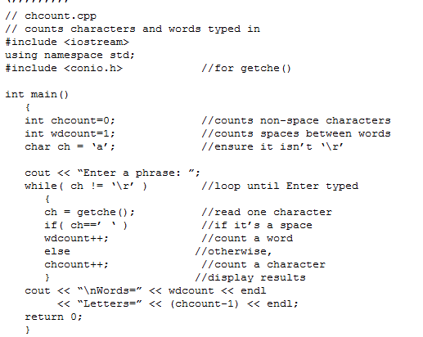

Slide 27
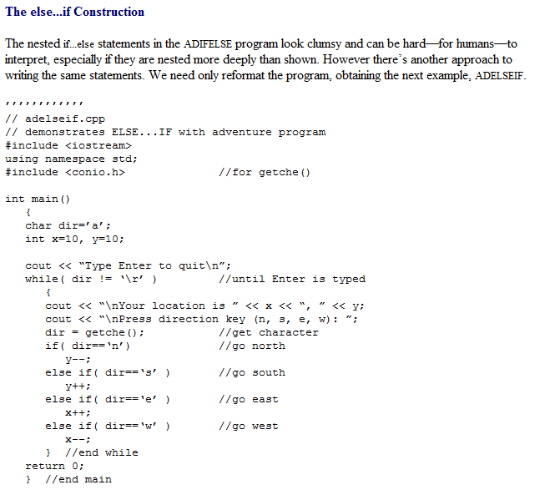

Slide 28
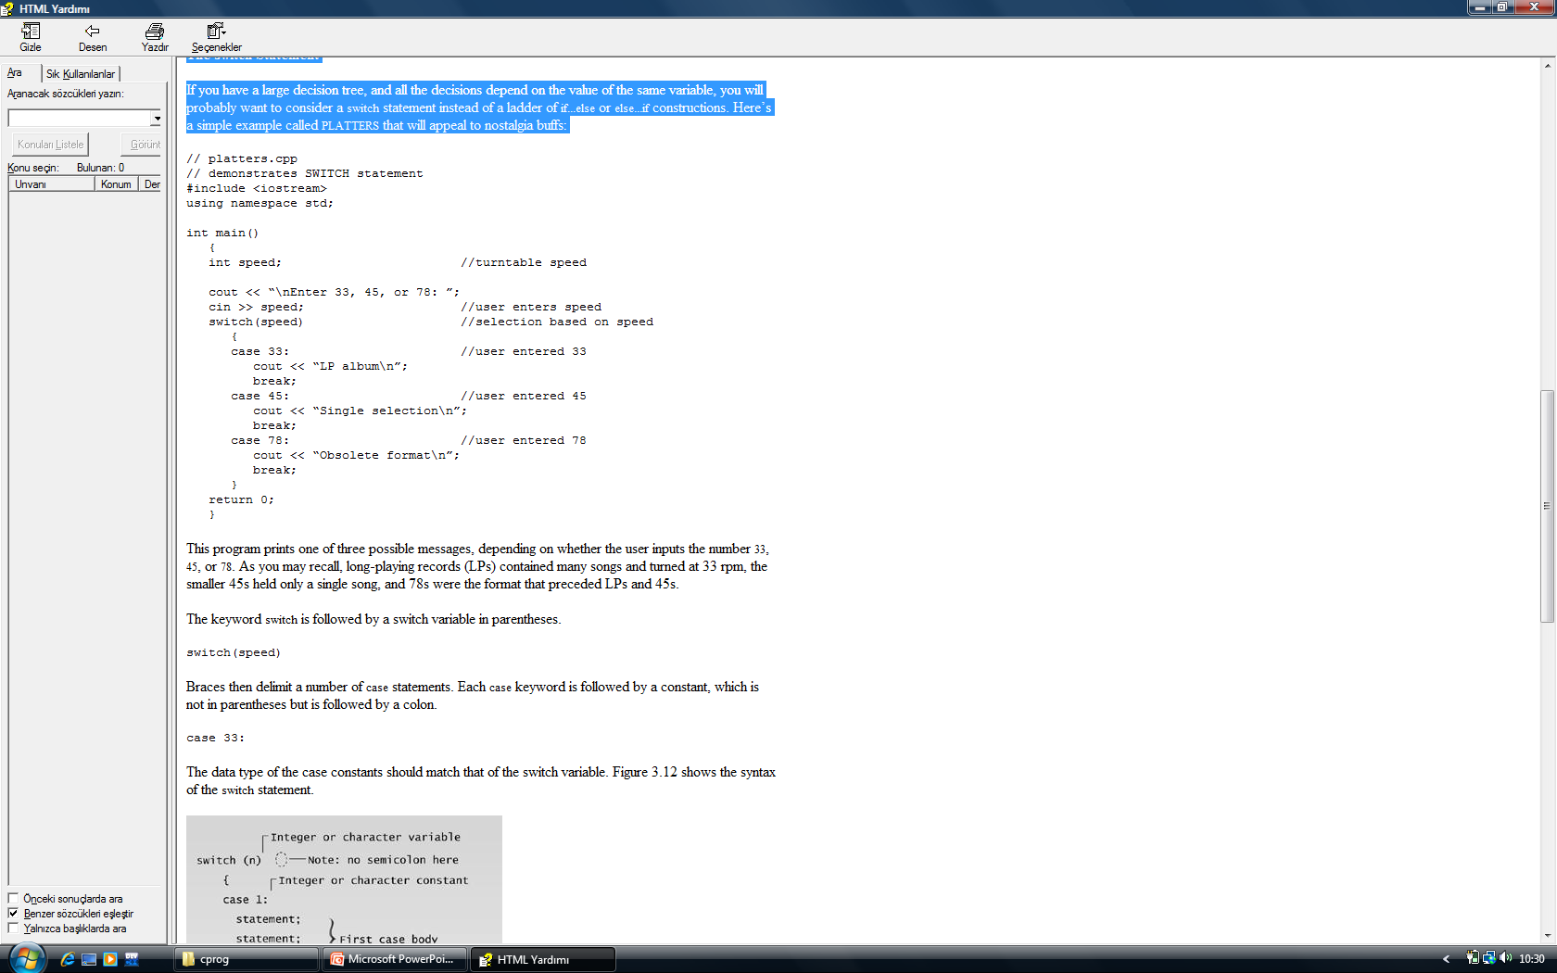
The switch Statement
If you have a large decision tree, and all the decisions depend on the value of the same variable, you will probably want to consider a switch statement instead of a ladder of if...else or else...if constructions.

Slide 29
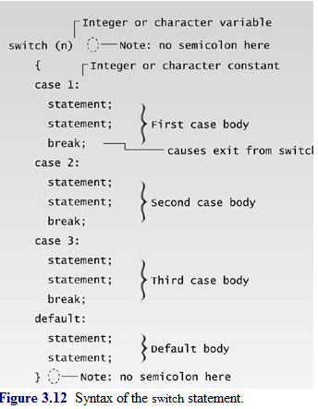
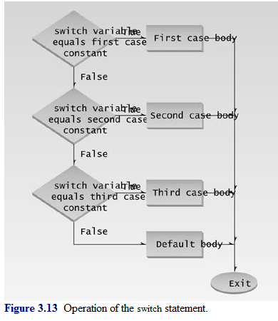

Slide 30
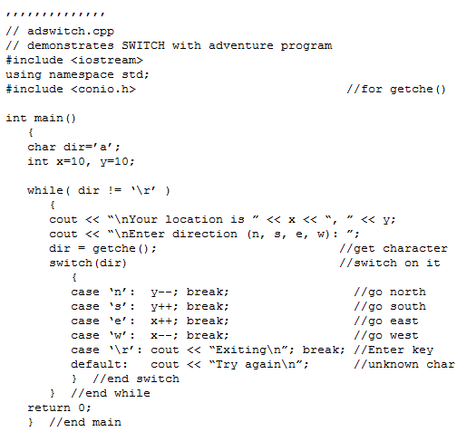

Slide 31
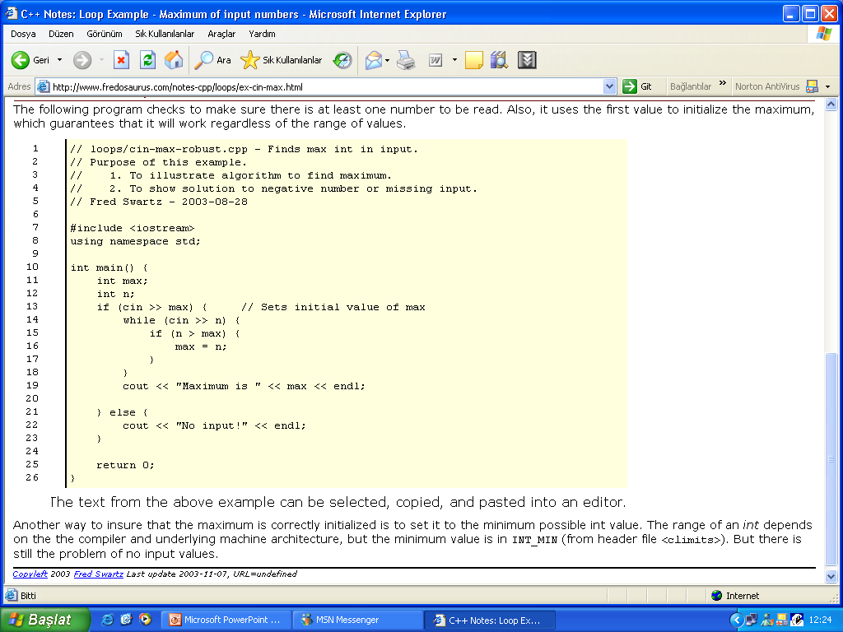

Slide 32
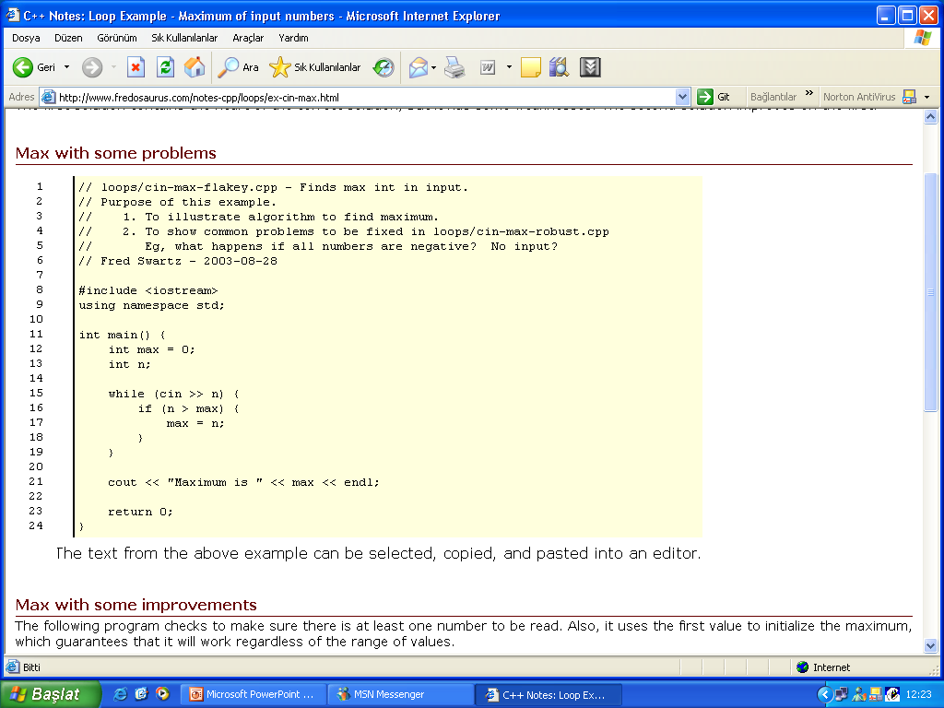

Slide 34
while
while
The while loop is used to execute a block of code as long as some condition is true. If the condition is false from the start the block of code is not executed at al. The while loop tests the condition before it's executed so sometimes the loop may never be executed if initially the condition is not met. Its syntax is as follows.
while (tested condition is satisfied)
{
block of code
}
In all constructs, curly braces should only be used if the construct is to execute more than one line of code. The above program executes only one line of code so it not really necessary (same rules apply to if...else constructs) but you can use it to make the program seem more understandable or readable.

Slide 35
Here is a simple example of the use of the while loop. This program counts from 1 to 100.
#include <stdio.h>
int main(void)
{
int count = 1;
while (count <= 100)
{
printf("%d\n",count);
count += 1; // Notice this statement
}
return 0;
}

Slide 36
do ....while
The do loop also executes a block of code as long as a condition is satisfied.
The difference between a "do ...while" loop and a "while {} " loop is that the while loop tests its condition before execution of the contents of the loop begins; the "do" loop tests its condition after it's been executed at least once.
As noted above, if the test condition is false as the while loop is entered the block of code is never executed. Since the condition is tested at the bottom of a do loop, its block of code is always executed at least once.
Some people don't like these loops because it is always executed at least once. When i ask them "so what?", they normally reply that the loop executes even if the data is incorrect. Basically because the loop is always executed, it will execute no matter what value or type of data is supposed to be required.
The "do ....while" loops syntax is as follows
do
{
block of code
} while (condition is satisfied);

Slide 37
Note that a semi-colon ( ; ) must be used at the end of the do ...while loop. This semi-colon is needed because it instructs whether the while (condition) statement is the beginning of a while loop or the end of a do ...while loop.
Here is an example of the use of a do loop.
include <stdio.h>
int main(void)
{
int value, r_digit;
printf(“Enter a number to be reversed.\n”);
scanf(“%d”, &value);
do
{
r_digit = value % 10;
printf(“%d”, r_digit);
value = value / 10;
} while (value != 0);
printf(“\n”);
return 0;
}

Slide 38
The following program is short, but it demostrates a while loop being used to ensure valid user keyboard input. It asks users if they want to continue. You might want to incorporate this program into a larger one that requires user permision to continue. The text remains onscreen until the user tells the program to continue executing.
/* Input routine to ensure that user types a correct response. This routine might be part of a larger program. */
include <stdio.h>
int main(void)
{
char ans;
printf(“Do you want to continue (y/n) ? ”);
scanf(“ %c”, &ans); // Get user’s answer
While((ans != ‘Y’) && (ans != ‘N’))
{printf(“\n You must type a Y or an N \n”); // warn
// and ask
printf(“ Do you want to continue (Y/N) ? ”); // again
sacnf(“%c”, &ans); } // Body of while loop ends here
return 0;
}

Slide 39
The following program asks users for a first name, then uses a while loop to count the number of characters in the name. This is a string length program; that is, it counts characters until it reaches the null zero. Remember that the length of a string equals the number of characters in the string up to-but not including-the null zero.
/* Counts the number of letters in the user’s first name*/
include <stdio.h>
main(void)
{
char name[15]; // will hold users’s first name
int count=0; // will hold total characters in name
/* Get the users’s first name */
printf(“ What is your first name? ”);
scanf(“ %s”, name); // Get user’s name
While(name[count]>0) // loop until null zero reached
{
count++;
}
printf(“ Your name has %d characters ”, count)
return 0;
}

Slide 40
switch() case:
The switch case statement is a better way of writing a program when a series of if elses occurs. The general format for this is,
switch ( expression )
{
case value1:
program statement; ......
break;
case valuen:
program statement;
.......
break;
default:
program statement;
.......
break;
}
The keyword break must be included at the end of each case statement. The default clause is optional, and is executed if the cases are not met. The right brace at the end signifies the end of the case selections.

Slide 41
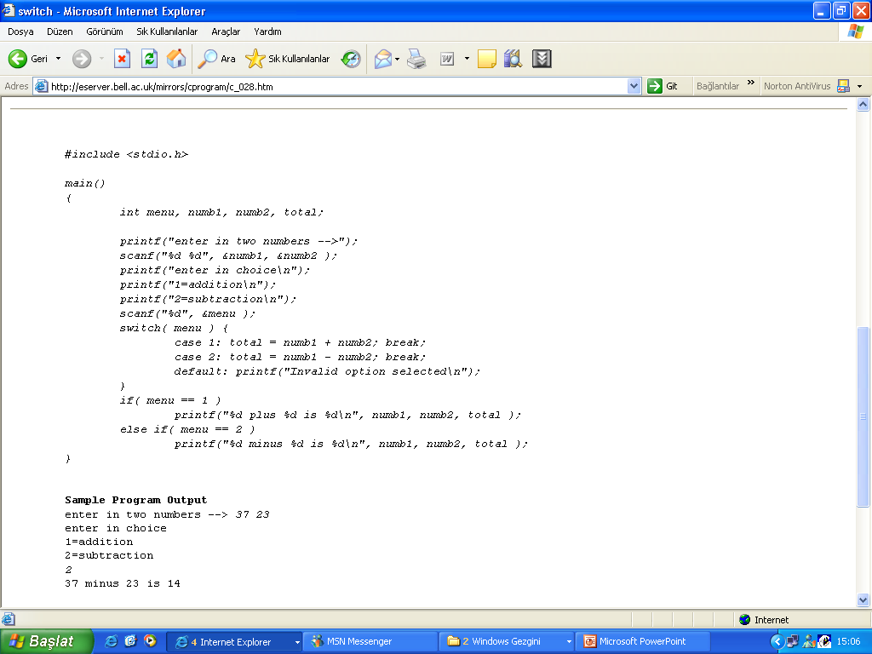
Rules for switch statements
values for 'case' must be integer or character constants the order of the 'case' statements is unimportant the default clause may occur first (convention places it last) you cannot use expressions or ranges :

Slide 42
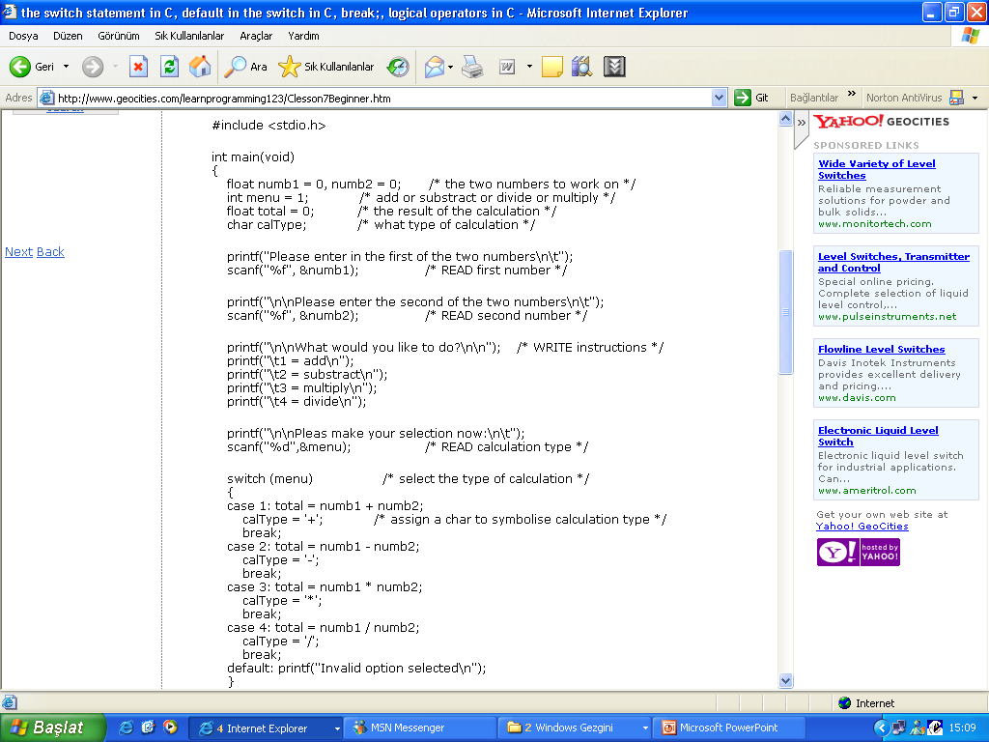

Slide 43
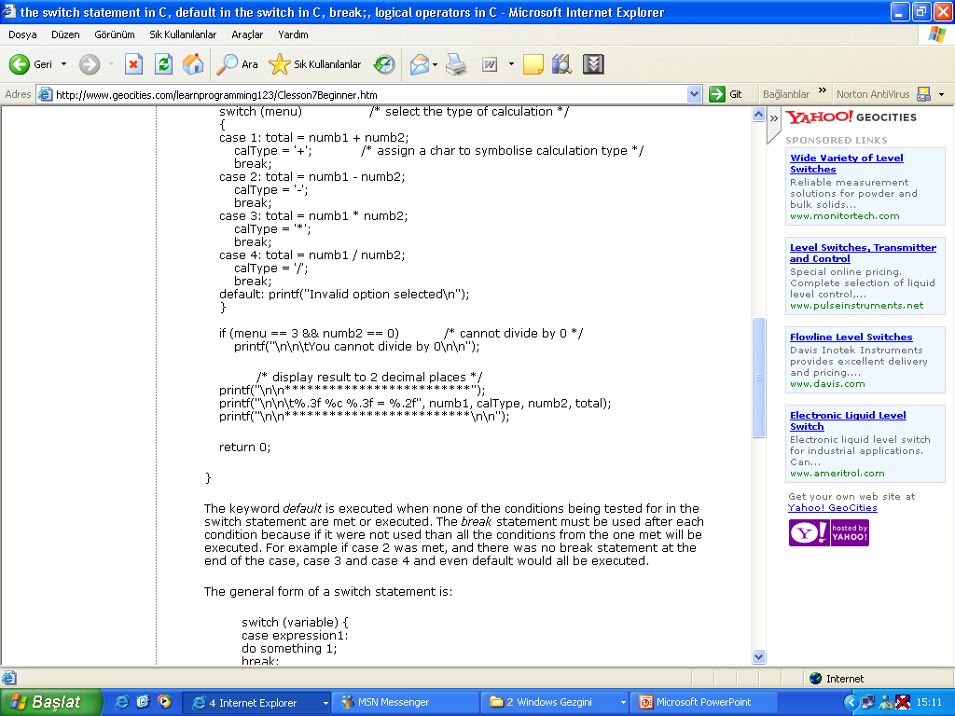

Slide 44
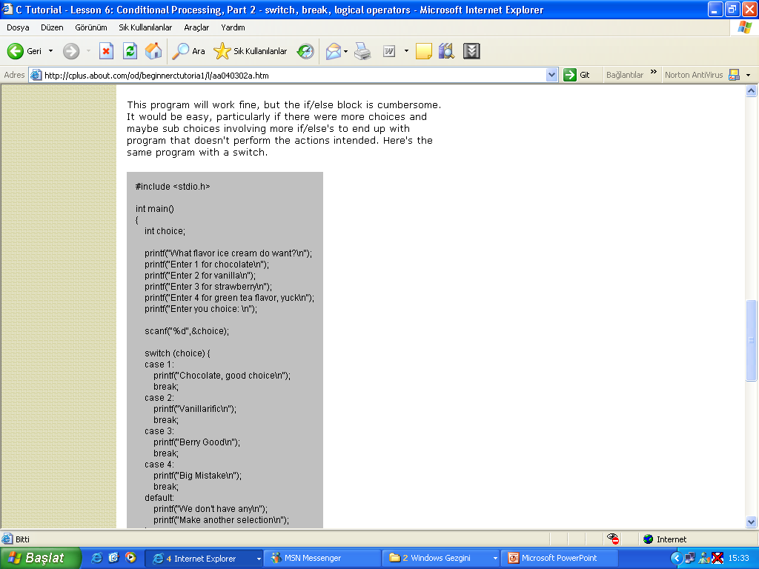
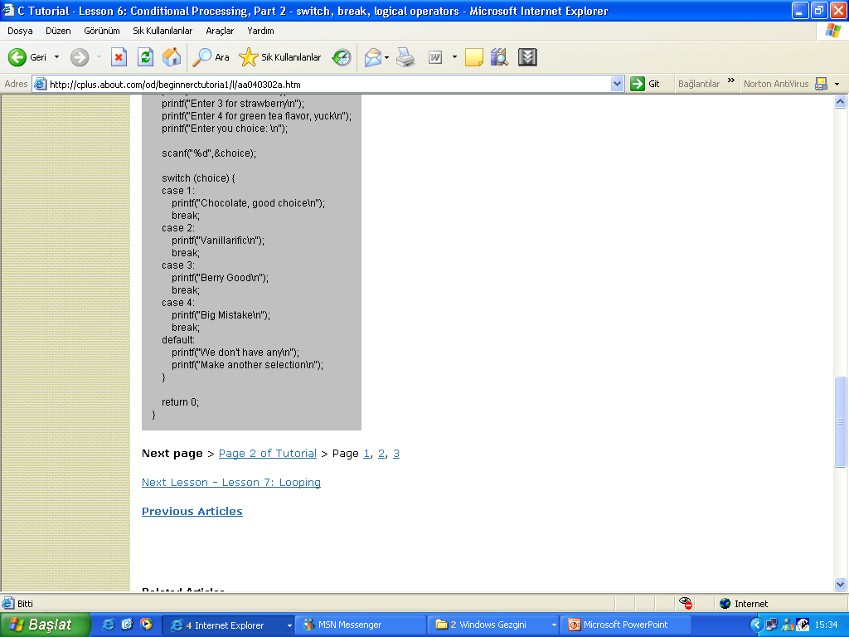

Slide 46
#include<stdio.h>
#include<math.h>
İnt Main()
{
İnt a,b,c;
Double x1,x2;
Double delta;
printf(“enter a:”);
Scanf(“%d”,&a);
printf(“enter b:”);
Scanf(“%d”,&b);
printf(“enter c:”);
Scanf(“%d”,&c);
Delta=pow(b,2) – 4*a*c;
İf(delta<0)
{
Printf(“reel sayılarda kökü yok”);
}
Else
{
X1=((-b) –sqrt(delta)) /2*a;
X2=((-b))+sqrt(delta)) /2*a;
Printf(“x1: %f\n”,x1);
Printf(“x2: %f\n”,x2);
}
Return 0;
}

Slide 47
#include<stdio.h>
#include<math.h>
İnt Main()
{
Char name[20]
float sum_salary,total_receipt,tax_return;
Prıntf(“ what is personel name ?”),
Scanf(“ %s “,name);
Printf(“\n what is sum_salary ?”);
Scanf(“ %f “,sum_salary);
Printf(“\n what is total_receipt ?”);
Scanf(“ %f “,sum_salary);
If(total_receipt>sum_salary)
{total_receipt=sum_salary;}

